Slide 1
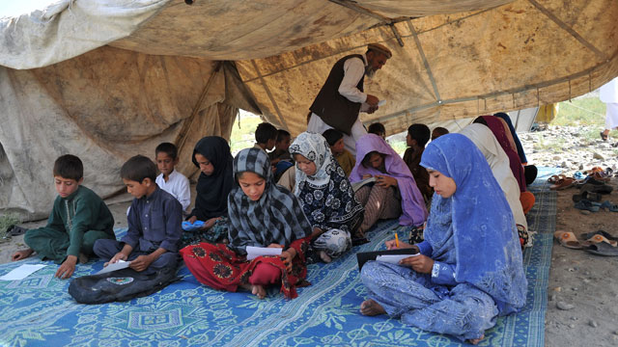
Iraq

Slide 2
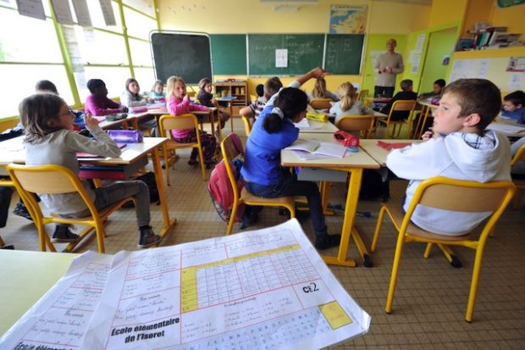
France

Slide 3

U.S.A.

Slide 4

Germany

Slide 5

Israel

Slide 6
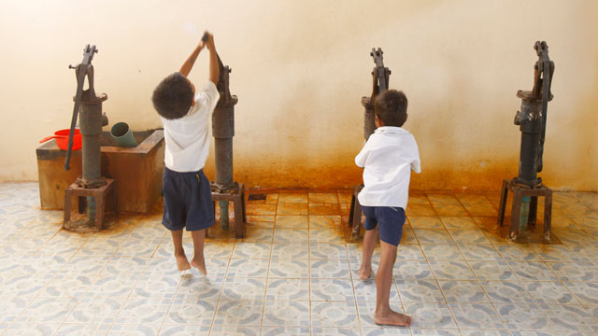
Cambodia

Slide 7
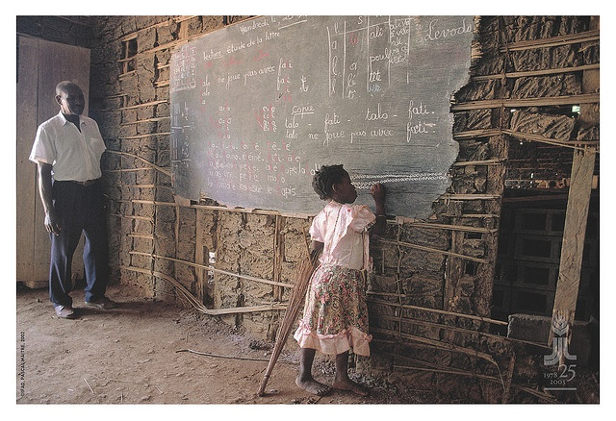
Cameroon

Slide 8
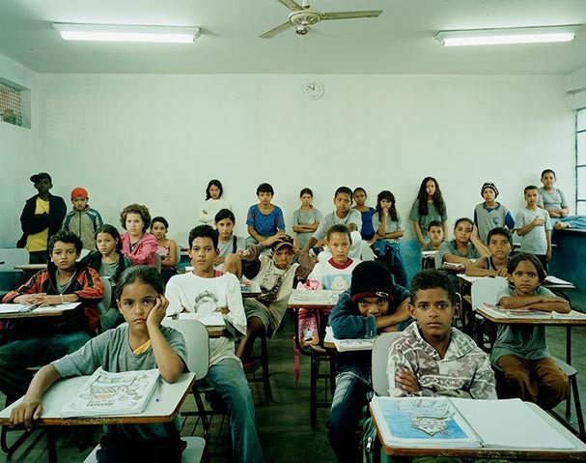
Brazil

Slide 9
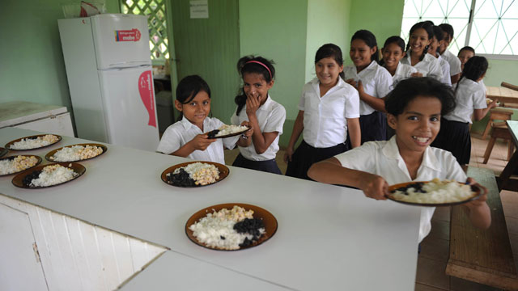
Costa Rica

Slide 10

Australia

Slide 11
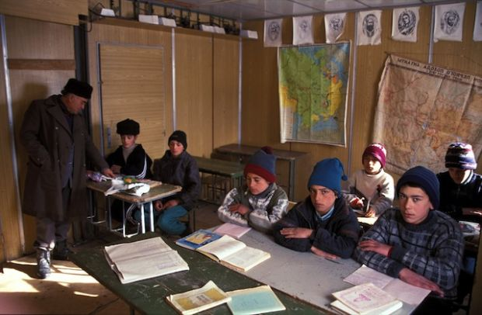
Tajikstan

Slide 12
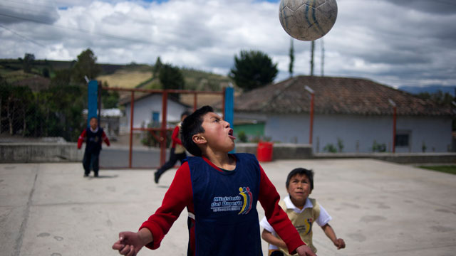
Ecuador

Slide 13
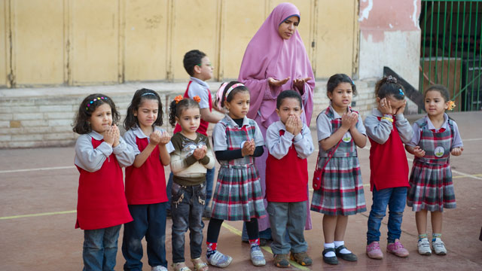
Egypt

Slide 14
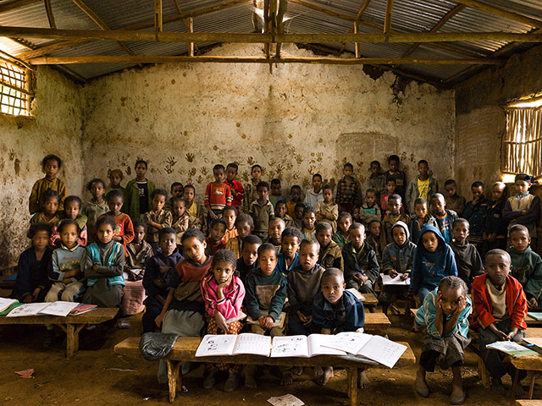
Ethiopia

Slide 15
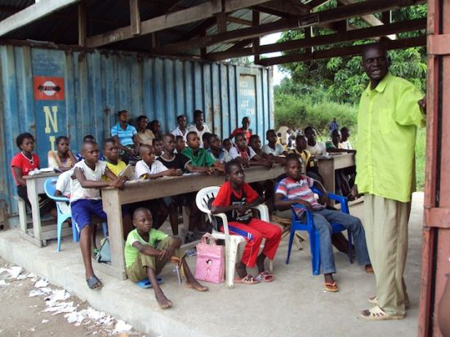
Democratic Republic of Congo

Slide 16
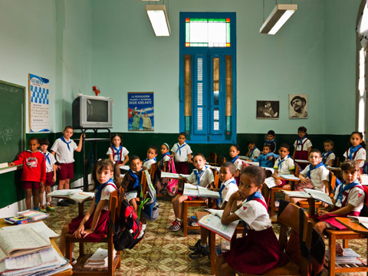
Cuba

Slide 17
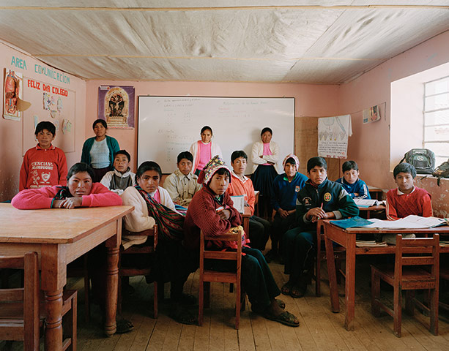
Peru

Slide 18

Holland

Slide 19

India

Slide 20
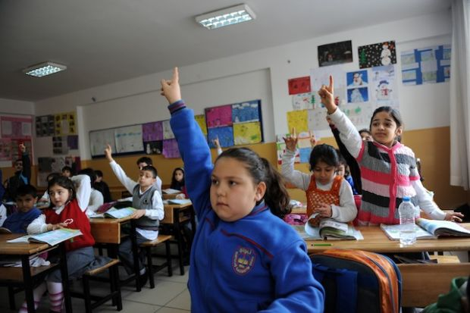
Turkey

Slide 21

Italy

Slide 22
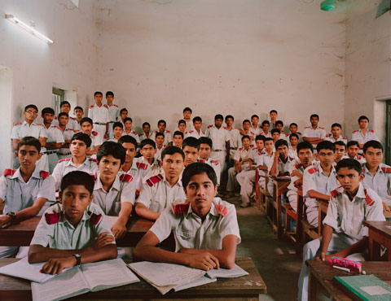
Bangladesh

Slide 23
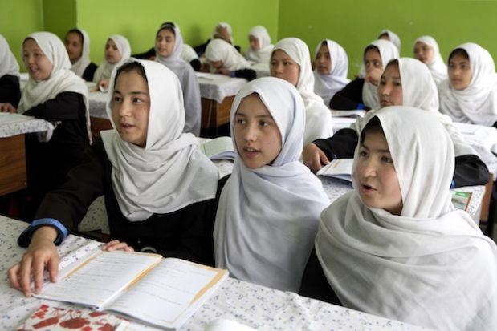
Afghanistan

Slide 24
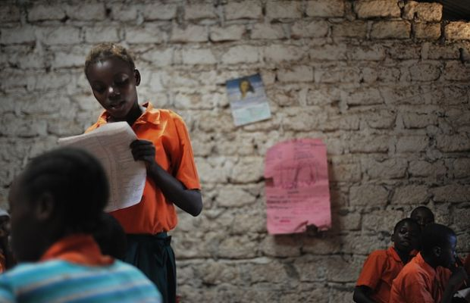
Kenya

Slide 25

England

Slide 26
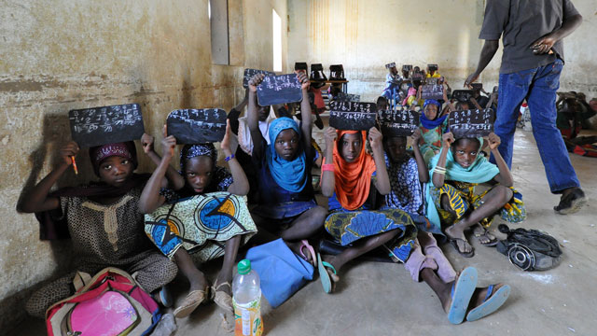
Mali

Slide 27

Russia

Slide 28
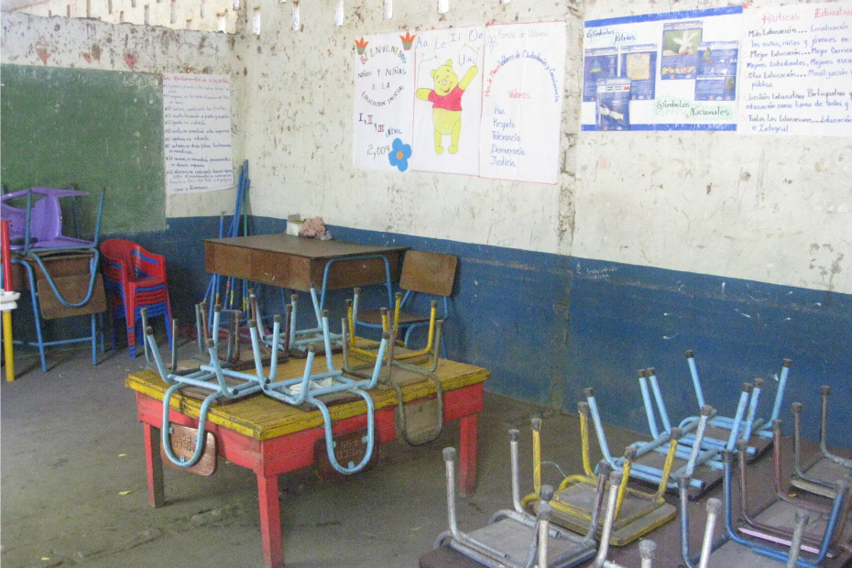
Nicaragua

Slide 29
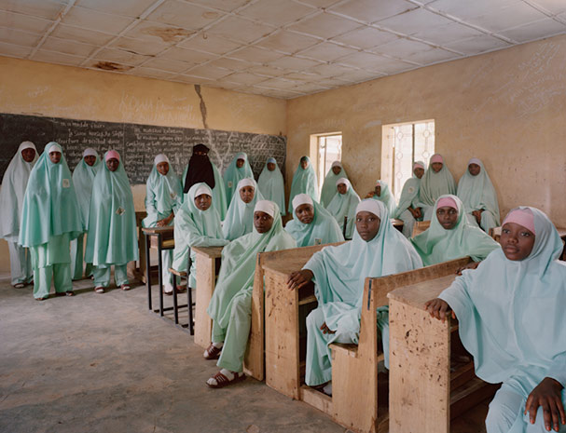
Nigeria

Slide 30
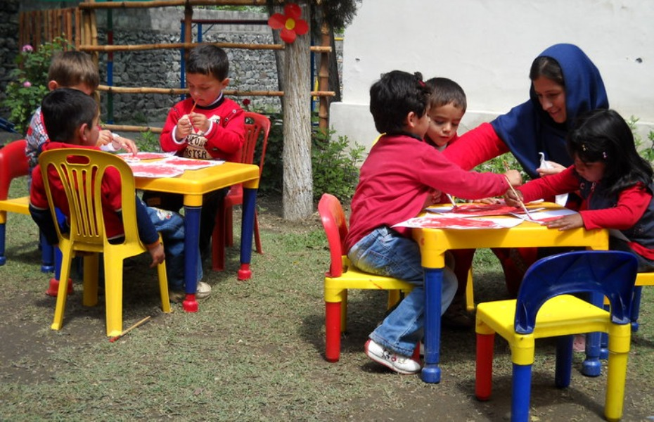
Pakistan

Slide 31

Philippines

Slide 32

Japan

Slide 33
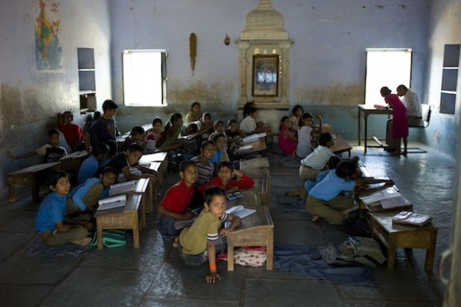
India

Slide 34

Chile

Slide 35

Saudi Arabia

Slide 36
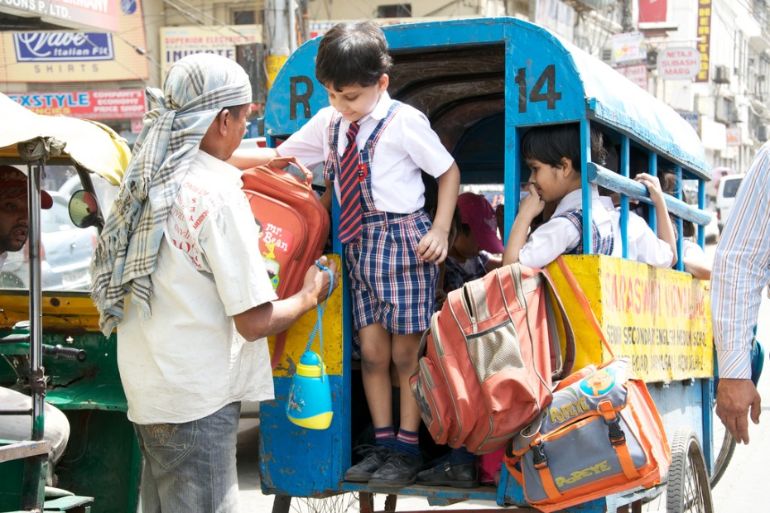
India

Slide 37
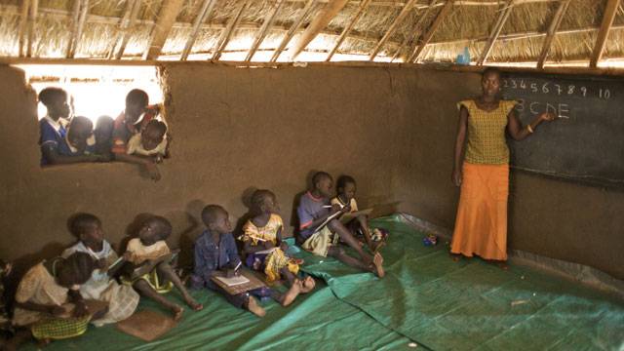
South Sudan

Slide 38

U.S.A.

Slide 39

Taiwan

Slide 40

Finland

Slide 41
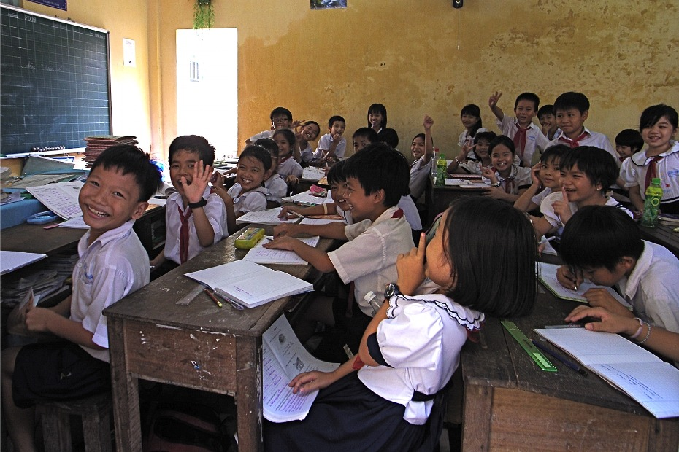
Vietnam

Slide 42
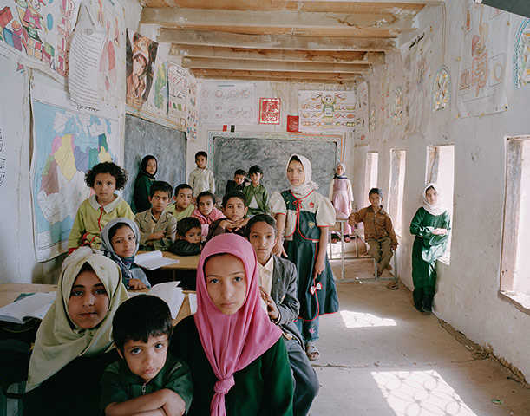
Yemen

